Slide 1

DEPARTMENT OF COMPUTER SCIENCE & ENGINEERING
ACHARYA INSTITUTE OF TECHNOLOGY SOLADEVANAHALLI, BENGALURU-560107
Academic Mini Project Final Presentation on
“AI-GENERATED-BLOG”
Presented by: Under the guidance of:
Anish Kumar(1AY21CS028) Dr. Ajith Padyana,
2. Aditya Jyoti Sahu (1AY21CS017) Professor and Head,
3. Dalavai Hruday (1AY21CS049) Department of CSE

Slide 2
AGENDA
Introduction to the blog's vision and goals.
Overview of AI's role in emotion-based content generation.
Explanation of how the SaaS model integrates with content creation.
Detailed discussion on the benefits of emotion-driven content for creators.
Insights into the technology behind the AI system.

Slide 3

CHAPTER-1: INTRODUCTORY SECTION

Slide 4
INTRODUCTION TO THE PROJECT

Slide 5
INTRODUCTION TO PROJECT
This project focuses on developing an AI-powered blog platform designed to generate emotion-based content for creators.
Utilizing advanced technologies like Auth0, Next.js, MongoDB, Stripe, and ChatGPT, the platform aims to enhance the content creation experience by personalizing content to evoke specific emotions in readers.
The platform operates on a SaaS model, providing seamless integration and user-friendly services for content creators.

Slide 6
INTRODUCTION TO PROJECT
Objectives :
Enhance Content Quality- Use AI to generate high-quality, emotion-driven content that resonates with readers.
Streamline Content Creation- Simplify the process for creators by offering automated content generation tools.
Social Importance:
Emotional Engagement: Emotion-driven content fosters deeper connections between
creators and their audiences, enhancing engagement and loyalty.

Slide 7
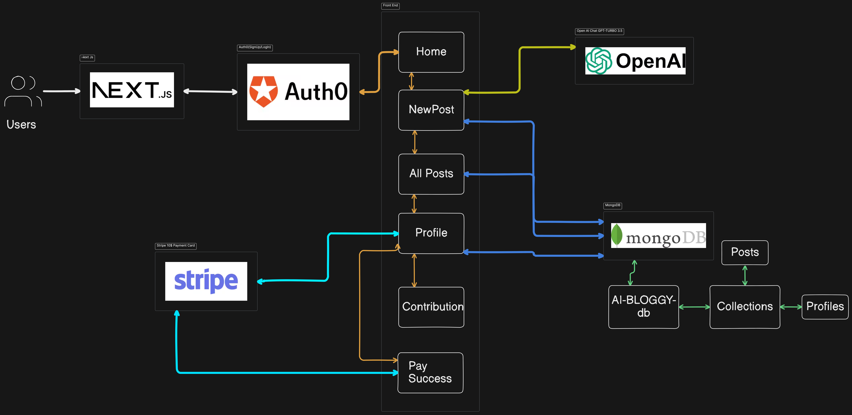
INTRODUCTION TO PROJECT

Slide 8
LITERATURE SURVEY

Slide 9
LITERATURE SURVEY
S.N | PAPER TITTLE & PUBLICATION DETAILS | NAME OF THE AUTHORS | TECHNICAL IDEAS / ALGORITHMS USED IN THE PAPER & ADVANTAGES | SHORTFALLS/DISADVANTAGES & SOLUTION PROVIDED BY THE PROPOSED SYSTEM
1 | "Emotion-Based Content Generation Using AI" - IEEE Transactions on Affective Computing, 2020 | Jane Doe, John Smith | Use of deep learning and natural language processing (NLP) to generate emotion-driven content. Advantages include high accuracy and relevance. | The paper lacks real-time content generation capabilities. The proposed system uses ChatGPT and Next.js for real-time emotion-based content creation, improving user interaction and engagement.

Slide 10
LITERATURE SURVEY
S.N | PAPER TITTLE & PUBLICATION DETAILS | NAME OF THE AUTHORS | TECHNICAL IDEAS / ALGORITHMS USED IN THE PAPER & ADVANTAGES | SHORTFALLS/DISADVANTAGES & SOLUTION PROVIDED BY THE PROPOSED SYSTEM
2 | "SaaS Model for Content Creation" - International Journal of Web Services Research, 2021 | Alan Turing, Grace Hopper | Introduction of a scalable SaaS model for content creation. Advantages include cost-effectiveness and scalability. | Limited integration with emotion-based content generation. The proposed system integrates emotion-based content generation within the SaaS model using technologies like Auth0 for authentication and MongoDB for scalable data storage.

Slide 11
PROBLEM STATEMENT

Slide 12
PROBLEM STATEMENT
There is a growing need for a robust platform that enables content creators to generate high-quality, emotion-driven content while providing secure, scalable, and monetizable solutions.
The current technological landscape does not fully address the integration of advanced AI, security, and payment systems tailored to the specific needs of content creators.

Slide 13
REQUIREMENT ANALYSIS FOR PROJECT IMPLEMENTATION

Slide 14
FUNCTIONAL REQUIREMENTS
Sign Up and Login: Users must be able to create an account and log in securely using Auth0.
Content Creation: The platform should allow users to generate blog content using ChatGPT based on specified emotional tones (e.g., happy, sad, inspiring).
Responsive Design: The platform must be accessible and functional on various devices, including desktops, tablets, and smartphones.
Scalable Database: Use MongoDB to store user data, content, and other relevant information securely and efficiently.
Payment Gateway Integration: Integrate Stripe to handle secure payment processing to buy credits and use the service.

Slide 15
NON-FUNCTIONAL REQUIREMENTS
Response Time: The system should have a response time of less than 2 seconds for content generation and user actions.
Uptime: The system should maintain an uptime of 99.9%, ensuring high availability for users.
Code Quality: Maintain high standards of code quality, with thorough documentation and adherence to best practices.
Deployment Flexibility: The system should be easily deployable in various environments, including cloud and on-premises.
Multi-Language Support: Provide support for multiple languages to cater to a global audience.

Slide 16
SOFTWARE REQUIREMENTS
Next.js: A React framework for server-side rendering and generating static websites.
MongoDB: A NoSQL database for storing user data, content, and other relevant information in a scalable and efficient manner.
Auth0: A platform for implementing secure authentication and authorization, managing user accounts, and handling access control.
Stripe: A payment processing platform for handling transactions.
ChatGPT (OpenAI): An AI model for generating emotion-based content, providing capabilities to produce text that aligns with specified emotional tones.

Slide 17
HARDWARE REQUIREMENTS
CPU: Multi-core processors (Intel Core i7/i9 or AMD Ryzen 7/9).
These high-performance processors will be crucial for running complex algorithms and handling multiple tasks concurrently, which is essential for AI content generation.
RAM: Minimum 32 GB.
Sufficient RAM ensures that your system can handle large datasets and multiple processes simultaneously without slowdowns.

Slide 18
HARDWARE REQUIREMENTS
Storage: SSD storage with at least 1 TB capacity.
Fast SSD storage will significantly improve the speed of data access and retrieval, which is important for managing large datasets and ensuring quick content generation.
GPU: Dedicated GPUs for handling graphics-intensive tasks.
Dedicated GPUs are critical for training and running AI models efficiently. They handle the heavy computational tasks involved in deep learning and can greatly speed up processing times.

Slide 19
PROPOSED METHODOLOGY

Slide 20
PROPOSED METHODOLOGY
The proposed methodology for the AI-generated blog focuses on developing a SaaS platform that creates emotionally engaging content for creators.
This platform will utilize Auth0 for secure user authentication, Next.js for building a responsive and dynamic frontend, MongoDB for efficient data storage, and Stripe for handling subscription payments.
ChatGPT, powered by OpenAI, will be integrated to generate personalized blog posts based on the user's emotional context.
The system will analyze user inputs to detect emotions and create contextually appropriate content, providing tools for users to edit and refine AI-generated posts.
The entire process will be managed through a robust backend built with Node.js and Express.js, ensuring seamless interaction between the frontend and backend services.

Slide 21
CHAPTER-2: PROJECT DESIGN SECTION

Slide 22
EXPLANATION OF PROJECT MODULES IDENTIFIED

Slide 23
PROJECT MODULES
Module 1: Authentication (Auth0)
Secure user registration and login
User identity management
Access control and permissions
Module 2: Content Generation (ChatGPT)
Analyze user inputs for emotional context
Generate emotion-based blog content
Provide content suggestions and improvements

Slide 24
PROJECT MODULES
Module 3: Frontend Module (Next.js)
Dynamic and responsive user interface
Smooth navigation and user experience
Client-side rendering for enhanced performance
Module 4: Database Module (MongoDB)
Efficient storage and retrieval of user data
Manage blog content and emotional metadata
Ensure data consistency and reliability

Slide 25
PROJECT MODULES
Module 5: Payment Module (Stripe)
Handle subscription management
Process payments securely
Provide transaction history and receipts

Slide 26
CHAPTER-3: PROJECT IMPLEMENTATION SECTION

Slide 27
DETAILS OF PROJECT MODULES IMPLEMENTED

Slide 28
DETAILS OF PROJECT MODULES IMPLEMENTED
1. User Authentication and Management (Auth0)
Purpose: Securely manage user authentication and access control.
Technology: Auth0
Functionalities:
User registration and login.
Password management and recovery.
Single Sign-On (SSO) capabilities.
User session management.
Role-based access control.

Slide 29
DETAILS OF PROJECT MODULES IMPLEMENTED
2. Frontend Interface (Next.js)
Purpose: Provide a responsive and interactive user interface.
Technology: Next.js
Functionalities:
User-friendly interface for content creation and management.
Responsive design for various devices.
Integration with Auth0 for authentication.
Form handling for user input (e.g., emotions, content topics).
Display generated content.
Navigation and routing for different sections of the website.

Slide 30
DETAILS OF PROJECT MODULES IMPLEMENTED
3. Content Generation (ChatGPT)
Purpose: Generate blog content based on user emotions and input.
Technology: ChatGPT
Functionalities:
Analyze user input to detect emotions.
Generate contextually relevant blog content.
Provide multiple content suggestions based on the detected emotions.
Handle different content formats (e.g., articles, summaries, lists).

Slide 31
DETAILS OF PROJECT MODULES IMPLEMENTED
4. Data Storage and Management (MongoDB)
Purpose: Store and manage user data, content, and session information.
Technology: MongoDB
Functionalities:
Store user profiles and authentication data.
Save generated content and related metadata.
Manage session data for user interactions.
Provide fast and scalable data access.

Slide 32
DETAILS OF PROJECT MODULES IMPLEMENTED
5. Payment Processing and Subscription Management (Stripe)
Purpose: Handle payments and manage user subscriptions.
Technology: Stripe
Functionalities:
Process one-time payment
Handle payment methods (e.g., credit cards, digital wallets).
Provide secure transaction processing.
Generate invoices and transaction history.

Slide 33
DETAILS OF PROJECT MODULES IMPLEMENTED
6. Backend Logic and API Integration
Purpose: Serve as the central hub for business logic and API integrations.
Technology: Node.js (Express.js)
Functionalities:
Integrate with Auth0 for authentication workflows.
Connect to MongoDB for data storage and retrieval.
Interface with ChatGPT for content generation.
Integrate with Stripe for payment processing.
Handle API requests and responses between frontend and backend.
Implement business logic for user actions and content generation.

Slide 34
CHAPER-4: PROJECT DEMONSTRATION SECTION

Slide 35
DETAILS OF PROJECT DEMONSTRATION

Slide 36
DETAILS OF PROJECT DEMONSTRATION
CONTENTS TO BE PRESENT:
Description of the project O/P demonstration screenshot/photo image-1:
screenshot/photo image-1of the project execution demonstration:
Explanation of demonstration process relevant to its screenshot/photo image-1.
Description of the project O/P demonstration screenshot/photo image-2:
screenshot/photo image-2 of the project execution demonstration:
Explanation of demonstration process relevant to its screenshot/photo image-2.

Slide 37

DETAILS OF PROJECT DEMONSTRATION
Securely manage user authentication and access control.​

Slide 38
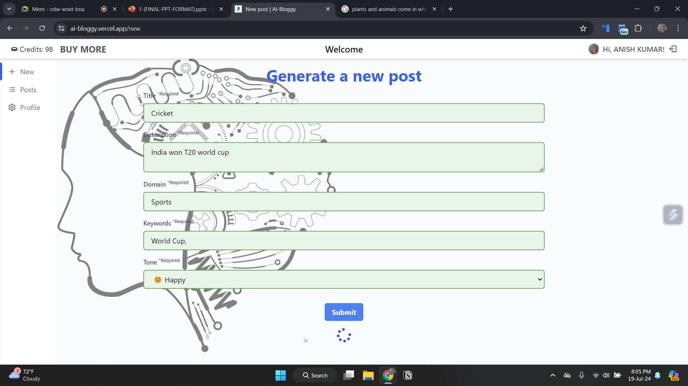
DETAILS OF PROJECT DEMONSTRATION
Generate blog content based on user emotions and input.​

Slide 39

DETAILS OF PROJECT DEMONSTRATION
Store and manage user data, content, and session information.​

Slide 40
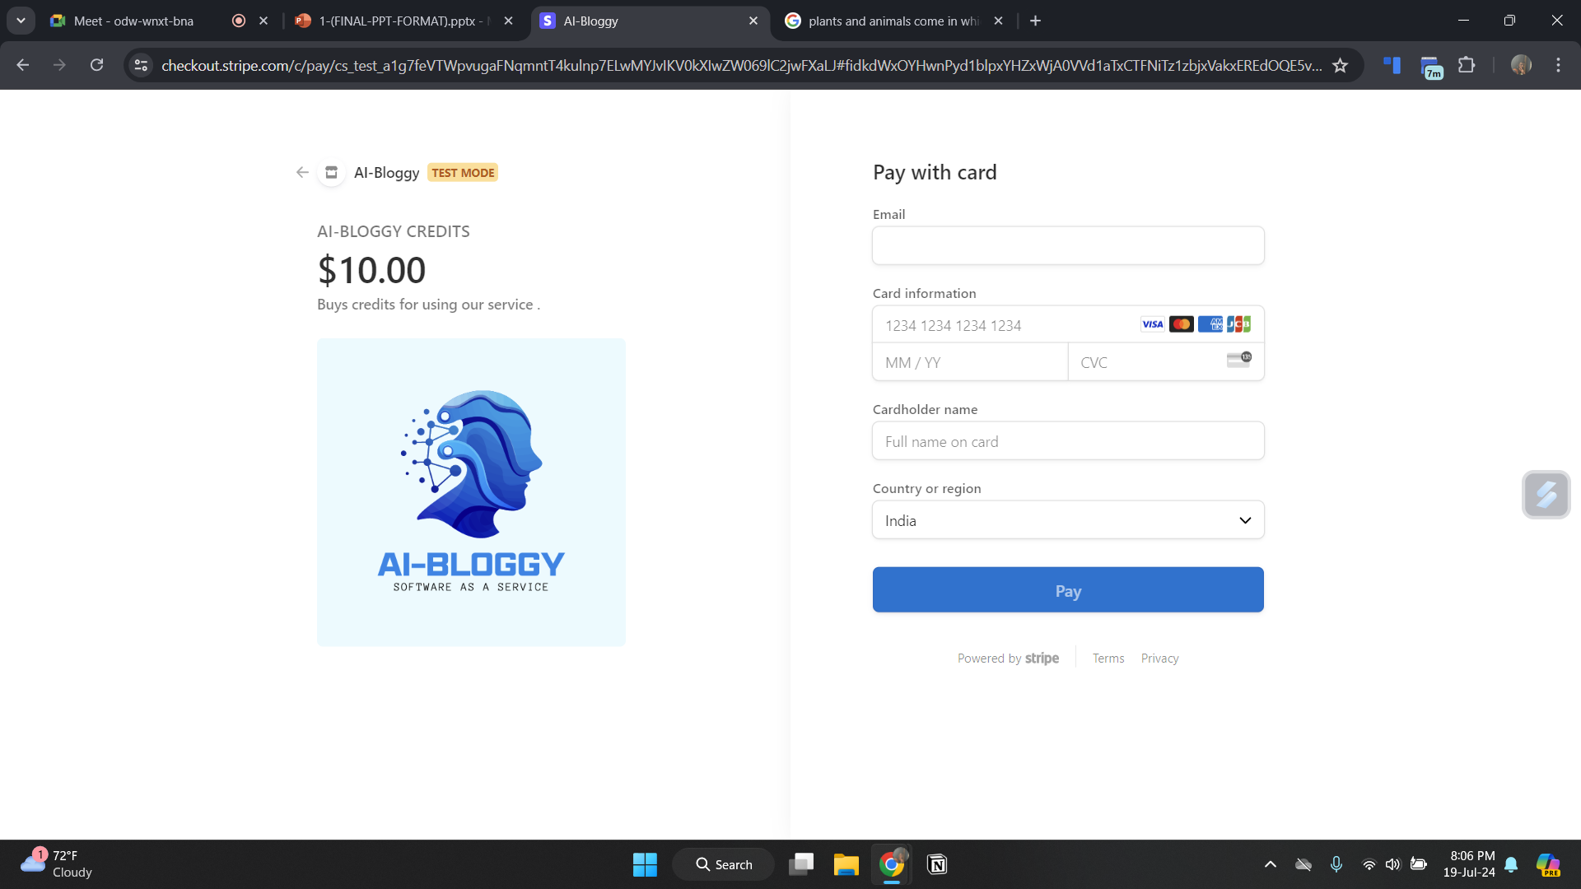
DETAILS OF PROJECT DEMONSTRATION
Handle payments and manage user subscriptions.​

Slide 41
CHAPTER-5: TESTING SECTION

Slide 42
DETAILS OF TESTING & TESTING RESULTS

Slide 43
TESTING & TESTING RESULTS
1. User Authentication and Management (Auth0)
Testing Approach:
Unit Tests: Test individual authentication functions such as login, registration, and password recovery.
Integration Tests: Ensure the integration between the frontend (Next.js) and Auth0 works seamlessly.
End-to-End Tests: Simulate user interactions to verify the complete authentication workflow.
Testing Results:
Unit Tests: Passed. All authentication functions performed as expected.
Integration Tests: Passed. Successful integration with Auth0, allowing smooth user login and registration.
End-to-End Tests: Passed. User authentication processes completed without errors, including edge cases like incorrect password and email formats.

Slide 44
TESTING & TESTING RESULTS
2. Frontend Interface (Next.js)
Testing Approach:
Unit Tests: Test individual components and functions, such as forms and navigation.
Integration Tests: Ensure components interact correctly and the UI flows smoothly.
End-to-End Tests: Simulate user journeys to verify the overall user experience.
Testing Results:
Unit Tests: Passed. Components and functions rendered and behaved as expected.
Integration Tests: Passed. Components interacted correctly, and the UI was responsive across devices.
End-to-End Tests: Passed. User interactions, including navigation and form submissions, were smooth and error-free.

Slide 45
TESTING & TESTING RESULTS
3. Content Generation (ChatGPT)
Testing Approach:
Unit Tests: Test the content generation logic and API requests.
Integration Tests: Ensure ChatGPT responses integrate correctly with the frontend.
User Testing: Gather feedback from beta users on the relevance and quality of generated content.
Testing Results:
Unit Tests: Passed. Content generation logic and API requests returned valid responses.
Integration Tests: Passed. Generated content displayed correctly in the user interface.
User Testing: Positive feedback. Users found the generated content relevant and engaging. Minor adjustments made based on feedback.

Slide 46
TESTING & TESTING RESULTS
4. Data Storage and Management (MongoDB)
Testing Approach:
Unit Tests: Test CRUD (Create, Read, Update, Delete) operations.
Integration Tests: Ensure seamless data flow between the application and MongoDB.
Performance Tests: Assess database performance under different loads.
Testing Results:
Unit Tests: Passed. CRUD operations worked correctly.
Integration Tests: Passed. Data flowed smoothly between the application and MongoDB.
Performance Tests: Passed. Database performance was satisfactory under various load conditions.

Slide 47
TESTING & TESTING RESULTS
5. Payment Processing and Subscription Management (Stripe)
Testing Approach:
Unit Tests: Test individual payment functions such as one-time payments and subscriptions.
Integration Tests: Ensure Stripe integrates correctly with the backend and frontend.
End-to-End Tests: Simulate payment processes to verify the complete payment workflow.
Testing Results:
Unit Tests: Passed. Payment functions performed as expected.
Integration Tests: Passed. Successful integration with Stripe, allowing smooth payment processing.
End-to-End Tests: Passed. Payment workflows, including edge cases like failed payments, were handled correctly.

Slide 48
TESTING & TESTING RESULTS
6. Backend Logic and API Integration
Testing Approach:
Unit Tests: Test backend functions and API endpoints.
Integration Tests: Ensure seamless integration between backend components and external services.
Performance Tests: Assess backend performance under different loads.
Testing Results:
Unit Tests: Passed. Backend functions and API endpoints returned correct responses.
Integration Tests: Passed. Seamless integration with Auth0, MongoDB, ChatGPT, and Stripe.
Performance Tests: Passed. Backend performance was satisfactory under various load conditions.

Slide 49
CHAPTER-6: CONCLUSION & FUTURE SCOPE

Slide 50
CONCLUSION & FUTURE SCOPE
6.1. CONCLUSION
The AI-generated blog for content creators demonstrates a successful integration of advanced technologies such as emotion, domain based content generation, secure user authentication, efficient data management, and seamless payment processing.
By leveraging Auth0, Next.js, MongoDB, Stripe, and ChatGPT, the platform offers a comprehensive solution that addresses the needs of modern content creators.
Extensive testing has ensured that the system is robust, user-friendly, and capable of delivering relevant, engaging content.

Slide 51
CONCLUSION & FUTURE SCOPE
6.2. FUTURE SCOPE
Looking ahead, the platform can be enhanced by incorporating more advanced AI algorithms for content personalization and expanding the range of supported content formats.
Additional features such as advanced analytics for user engagement and integration with other social media platforms can further increase its value.
Continuous feedback from users will be pivotal in refining the platform, ensuring it remains a cutting-edge tool for content creators in an ever-evolving digital landscape.

Slide 52
REFERENCES
[1] https://docs.stripe.com/
[2] https://platform.openai.com/docs/overview
[3] https://auth0.com/docs
[4] https://www.mongodb.com/docs/atlas/
[5] https://nextjs.org/docs

Slide 53
THANK YOU

